Slide 1
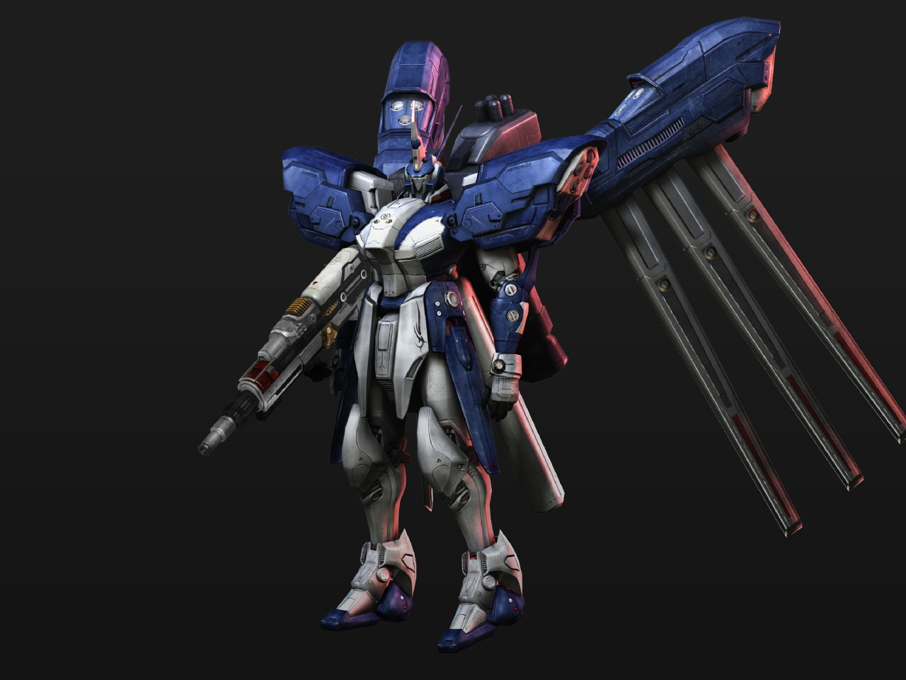
3d rendering
3D RENDERING

Slide 2
Intro
Konsep 3D
3D objects
Viewing &Clipping
Rendering

Slide 3
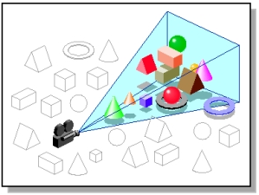
Viewing
Data disimpan dalam memori sementara

Slide 4

Clipping
Sama dengan clipping 2D

Slide 5
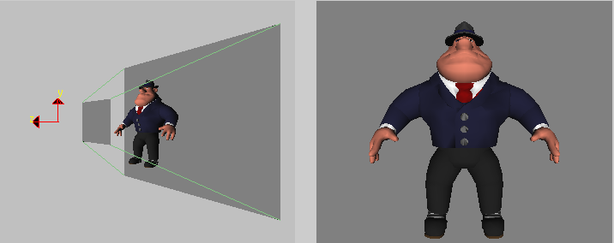
Rendering
Transformasi titik dalam 3D ke dalam bidang 2D.
Viewport/bidang pandang
Ruang Pandang di dunia
Ruang Pandang di Layar
y
z
x
Bidang pandang
(a)
(b)

Slide 6
Rendering
Rendering
Real-time
Non real-time
Projection
Etc.

Slide 7
Real-time
Non Real-time
Game hi-res
3d Movie & photo

Slide 8
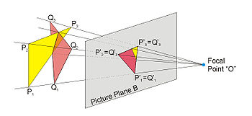

Projection
The shaded three-dimensional objects must be flattened so that the display device - namely a monitor - can display it in only two dimensions, this process is called 3D projection.

Slide 9

Testing with Blender
Semakin banyak efek & besar data 3D, semakin lama proses render.
Rendering time (second)
Size

Slide 10
Advantages & disadvantages
+ berguna untuk proyeksi 3D
- proses rendering yang memerlukan banyak waktu
Ingat! Proses rendering sangat diperlukan bagi banyak aplikasi terlebih multimedia.

Slide 11
Reference
Wikipedia
google

Slide 12
Thank you
©2011

